Slide 1
Traffic Sign detection
卢博
11849159

Slide 2
HOG+SVM
HOG: Extract features
SVM: Classifier(Optimize here)

Slide 3


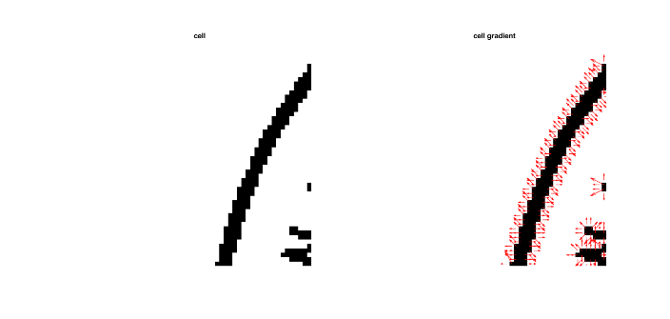
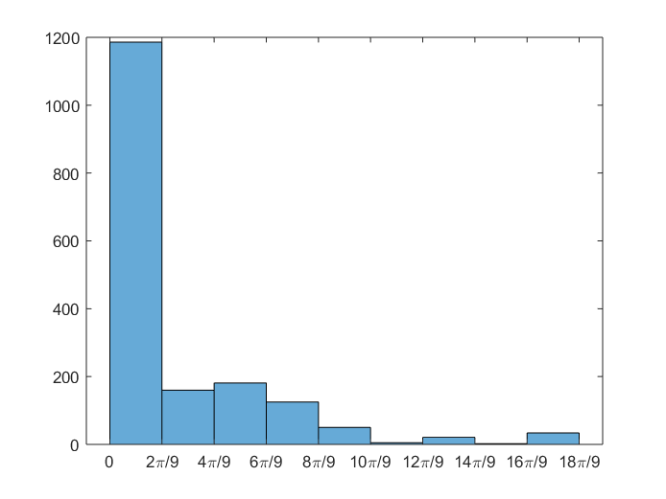
HOG
HOG: (Histogram of Oriented Gradient)
Divide image into small connected areas, which we call cell. A gradient or edge direction histogram of each pixel in the cell is then acquired. These histograms can be combined to form a feature descriptor.
Cell
Block

Slide 4
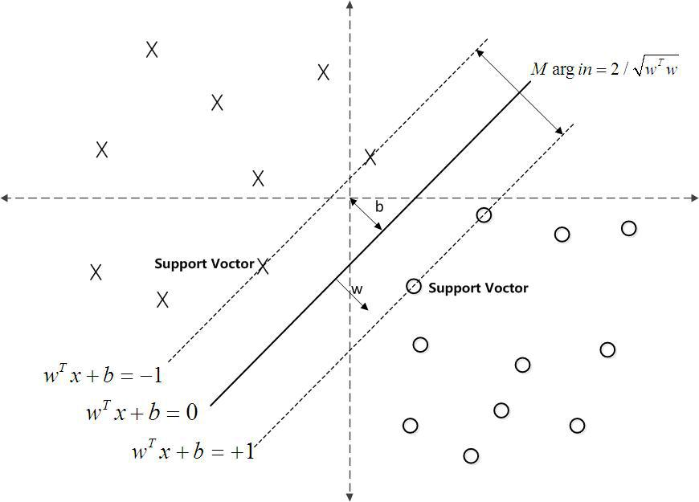
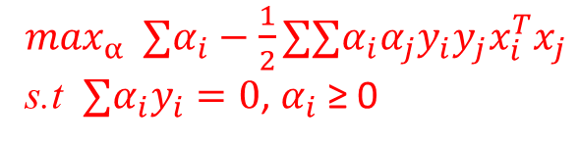
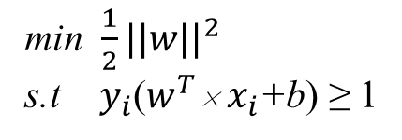

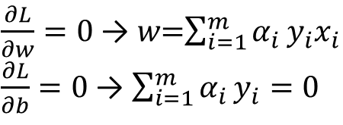
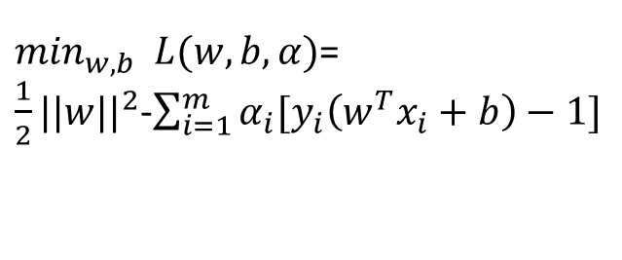
SVM
$\min_{w,b}⁡$ $L(w,b,α)$=
$\frac{1}{2}||\text{w}{||}^{2}$-$\sum_{i=1}^{m}{α_{i}[y_{i}\left(w^{T}x_{i}+b\right)−1]}$
$\frac{∂L}{∂w}=0$ → 𝑤=$\sum_{i=1}^{m}{α_{i}}y_{i}x_{i}$
$\frac{∂L}{∂b}=0$ → $\sum_{i=1}^{m}{α_{i}}y_{i}=0$
$\max_{α}⁡$ $∑α_{i}−\frac{1}{2}∑∑α_{i}α_{j}y_{i}y_{j}x_{i}^{T}x_{j}$
s.t $∑α_{i}y_{i}=0$, $α_{i} \text{≥}\text{ 0}$
min $\frac{1}{2}||$𝑤${||}^{2}$
s.t $y_{i}$($w^{T}$× $x_{i}$+b) ≥ 1
So we need to get the $α_{i}$, then $w$
will be solved.

Slide 5
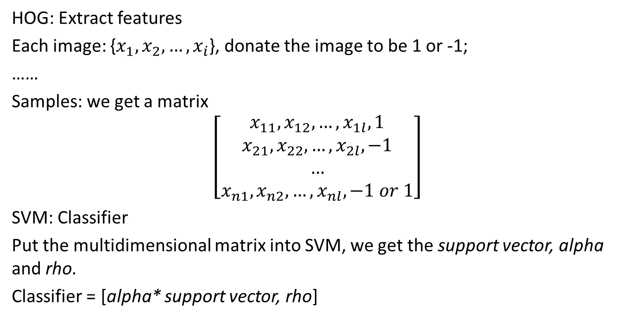
HOG+SVM
HOG: Extract features
Each image: {$x_{1},x_{2}, …,x_{i}$}, donate the image to be 1 or -1;
……
Samples: we get a matrix
$$\left[\begin{aligned}x_{11},x_{12}, …,x_{1l}, 1 \\ x_{21},x_{22}, …,x_{2l}, −1 \\ … \\ x_{n1},x_{n2}, …,x_{nl}, −1 or 1\end{aligned}\right]$$
SVM: Classifier
Put the multidimensional matrix into SVM, we get the support vector, alpha and rho.
Classifier = [alpha* support vector, rho]

Slide 6
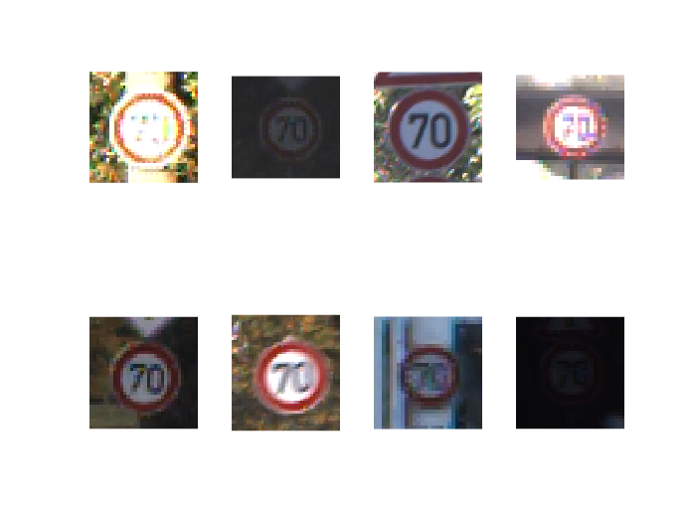
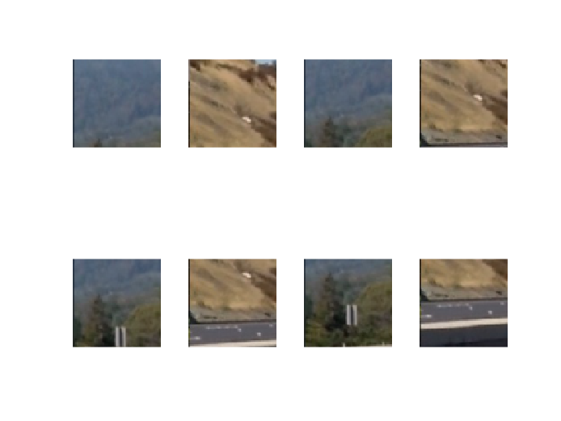

Project-train
Positive samples(1980): Mark as +1
Negative samples(1980): Mark as -1
Use HOG extract features:
For these 8 images, resize these images to 64×64, each cell have 9 feature, each block have 4 cell. If the sliding window moves every 8 pixels, then we get 7×7 windows. The number of the features is 9×4×7×7=1764.
pos feature neg feature
$\left[\begin{aligned}x_{1,1},x_{1,2}, …,x_{1,1764}, 1 \\ x_{2,1},x_{2,2}, …,x_{2,1764}, 1 \\ … \\ x_{8,1},x_{8,2}, …,x_{8,1764}, 1\end{aligned}\right]$ $\left[\begin{aligned}x_{1,1},x_{1,2}, …,x_{1,1764}, −1 \\ x_{2,1},x_{2,2}, …,x_{2,1764}, −1 \\ … \\ x_{8,1},x_{8,2}, …,x_{8,1764}, −1\end{aligned}\right]$

Slide 7
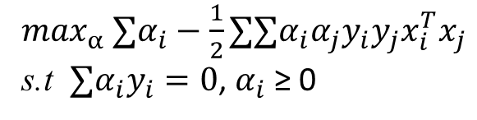
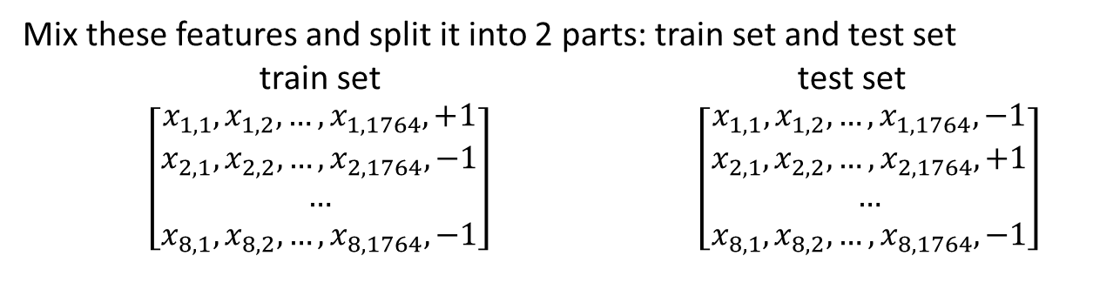
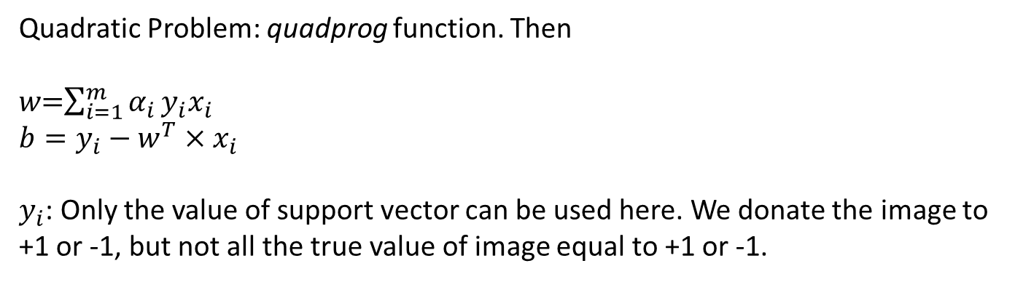
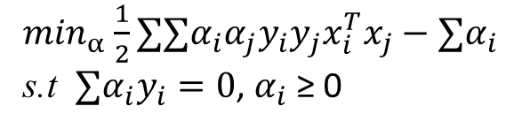
Project-train
Mix these features and split it into 2 parts: train set and test set
train set test set
$\left[\begin{aligned}x_{1,1},x_{1,2}, …,x_{1,1764}, +1 \\ x_{2,1},x_{2,2}, …,x_{2,1764}, −1 \\ … \\ x_{8,1},x_{8,2}, …,x_{8,1764}, −1\end{aligned}\right]$ $\left[\begin{aligned}x_{1,1},x_{1,2}, …,x_{1,1764}, −1 \\ x_{2,1},x_{2,2}, …,x_{2,1764}, +1 \\ … \\ x_{8,1},x_{8,2}, …,x_{8,1764}, −1\end{aligned}\right]$
$\max_{α}$ $∑α_{i}−\frac{1}{2}∑∑α_{i}α_{j}y_{i}y_{j}x_{i}^{T}x_{j}$
s.t $∑α_{i}y_{i}=0$, $α_{i} \text{≥}\text{ 0}$
$\min_{α}$ $\frac{1}{2}∑∑α_{i}α_{j}y_{i}y_{j}x_{i}^{T}x_{j}−∑α_{i}$
s.t $∑α_{i}y_{i}=0$, $α_{i} \text{≥}\text{ 0}$
Quadratic Problem: quadprog function. Then
𝑤=$\sum_{i=1}^{m}{α_{i}}y_{i}x_{i}$
$$b=y_{i}−w^{T}×x_{i}$$
$y_{i}$: Only the value of support vector can be used here. We donate the image to
+1 or -1, but not all the true value of image equal to +1 or -1.

Slide 8
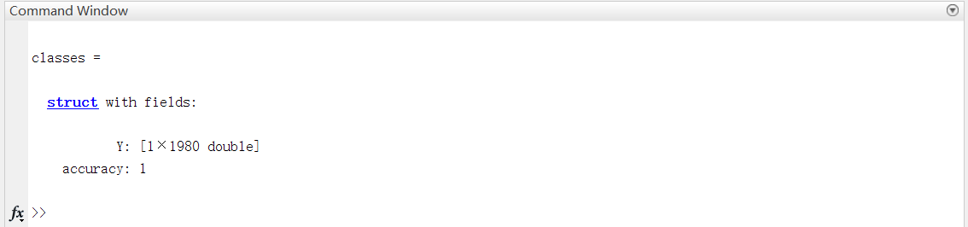
Project-test
Use the test set to get the accuracy of this model. The scale of this model is too small, so the accuracy is high.
My SVM
Matlab SVM

Slide 9
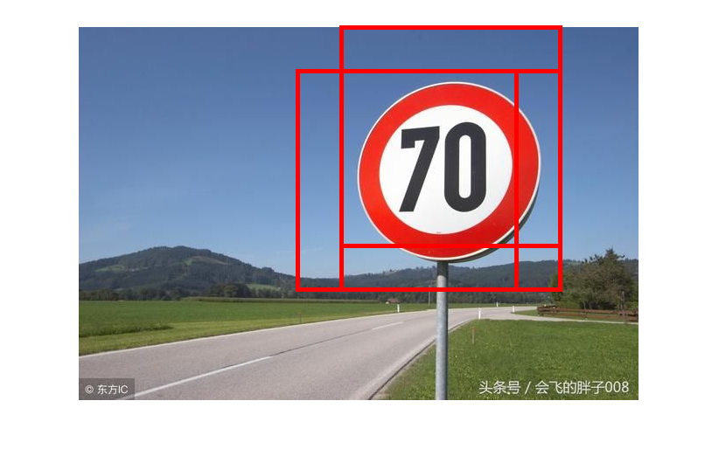

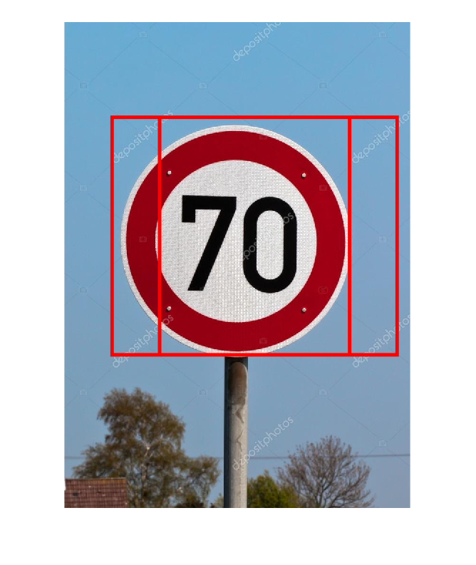
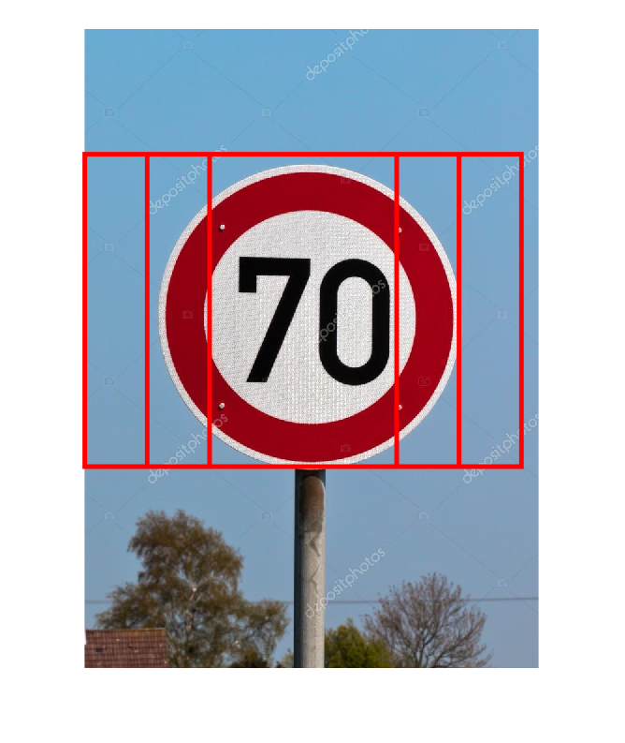
Project-predict
My SVM
Matlab SVM

Slide 10
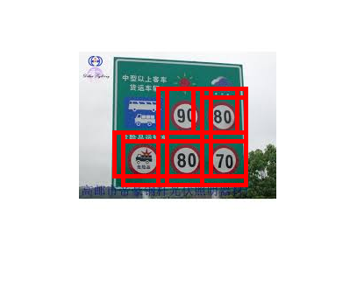

Project-summary
1. The sliding window’s size ?
In different images：1023×728, 427×640
The signs have different pixel sizes, how to design the window’s size.
2. Wrong detection.
Both My SVM and Matlab SVM have wrong detection.
My SVM
Matlab SVM

Slide 11
Reference
Zhao J D , Bai Z M , Chen H B . Research on Road Traffic Sign Recognition Based on Video Image[C]// International Conference on Intelligent Computation Technology & Automation. 2017.
Garrido M Á G, Sotelo M Á, Martíngorostiza E. Traffic sign detection in static images using Matlab[C]// Emerging Technologies & Factory Automation, Etfa 03 IEEE Conference. 2003.
凸优化-对偶问题 http://www.hanlongfei.com/convex/2015/11/05/duality/

Slide 12

Gantt Chart

